Slide 1

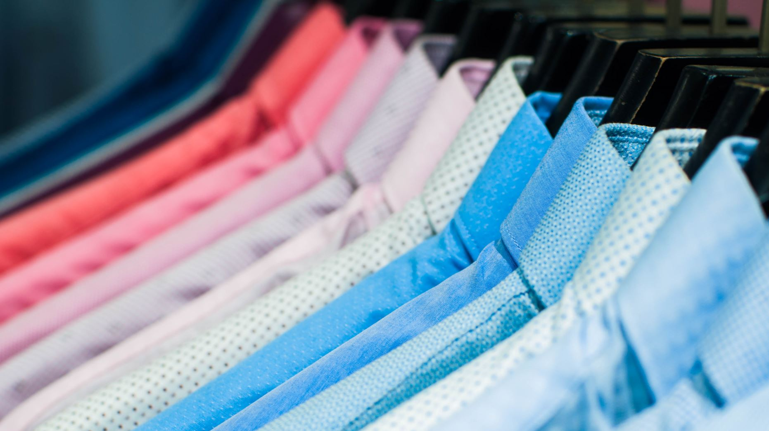

Goods Recommendation System
Mikhail Gudyrin
2021

Slide 2
Architecture overview. Model-View-Controller
Views
Book View
Film View
Laptop View
Models
Controllers
Book Recommender
Book Controller
Film Recommender
Film Controller
Laptop Recommender
Laptop Controller

Slide 3
Application Architecture
View
Web UI
HMTL, JavaScript, etc.
Model
Data loading and preprocessing
Recommendation metric calculation
Result verification
Python: NumPy, Pandas
Controller
User input sanitizing
Data transfer inside application
Python: Flask

Slide 4
Questions

